Slide 1
Data Representation and Organization
CSC 101 – Introduction to Computer Science
Lecture 18
Department of
Computer Science and Engineering,
Independent University, Bangladesh

Slide 2
Today
Analysis of data representation for different domains
structs

Slide 3
Data Representation and Organization
The organization and representation of data is very important for writing correct and efficient code
Half the battle!
For smaller programs choices are often obvious …

Slide 4
Data Representation For Board Games
Tic-Tac-Toe
Chess
Sudoku
Mastermind
Monopoly
Scrabble
Others?

Slide 5
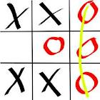
Tic-Tac-Toe
Board
  2D array of symbols
  3x3
Symbols
  char : ‘X’, ‘O’,
      and ‘ ‘ (blank)

Slide 6
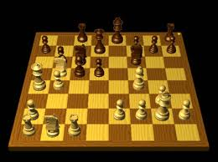
Chess
Board
  2D array of Pieces
  8x8
Pieces
  chars …
  properties
    movement
    team
    place in board

Slide 7
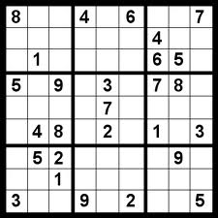
Sudoku
Board
  9 2D array of integers
  Each 3x3
Pieces
  none

Slide 8
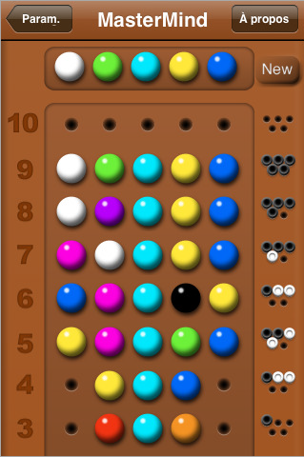
Mastermind
Board
  1 1D array of Pegs
  1 1D array of Pegs
  1 1D array of Small Pegs
Pegs
  colors?
  can represent with integers or chars
Small Pegs

Slide 9
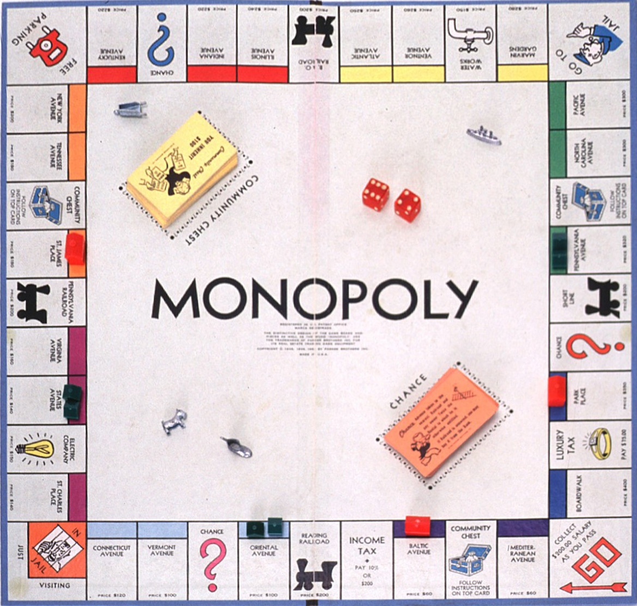
Monopoly
Board
  1 1D array of sites
  1 1D array of strings
  1 1D array of strings
Tokens
  ID
  1 D array : properties owned
Site
  can be property, utility, special (go, free parking)
  properties
    price : float
    tax : float
    sold : bool
    owner : token

Slide 10
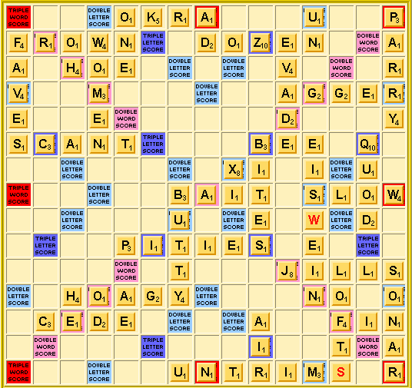
Scrabble
Board
  2D array of “squares”
  “squares” will have properties
    char value
    double letter/triple letter …
Pieces
  char
  value

Slide 11

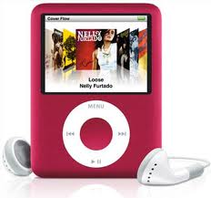




Representing Large Data Sets
Data representation becomes even more important for programs that deal with large volumes of data
Sometimes these program are called database applications
  major area within CS
  another emerging area : data mining
Inefficient data organization can incur huge costs
  Don’t want to do a billion string comparison each time a user searches for another user

Slide 12
Facebook
User
  ID
  Email
  Friends : ID of friends
  Notifications : array of notification
    Notification
      Message
      Photo
      Poke
      …
  …
Groups
Pages
What are the main entities?

Slide 13
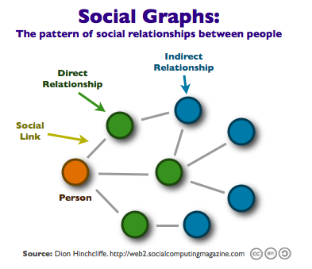
Facebook : Visual Representation
Graphs are a natural way to represent social networks
These graphs are not “function graphs” from continuous math
Many different ways to represent a graph in a program
Most involve the use of pointers, will postpone this discussion for now
Visually intuitive data representations are good!

Slide 14
Netflix
User
  ID
  email
  Credit card info
  Queue
    Instant
    DVD
  DVD at home
Movies
  Title
  Year
  Genre
  No of DVDs
Maybe stored separately for security reasons
What are the main entities?

Slide 15
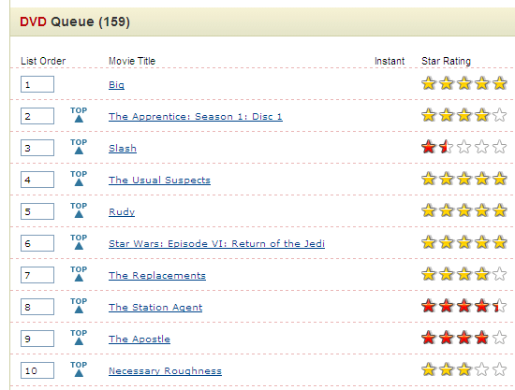
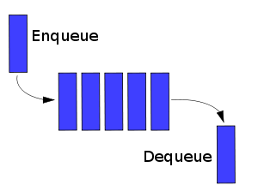
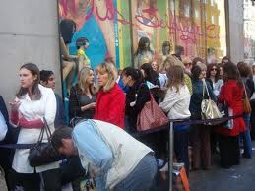

Representing “Queues”
Queue properties
  Dynamic size
    Maybe a hard upper limit
  Add to the end/back/bottom
  Extract from beginning/front/top

Slide 16
Structs
When programming it is often useful to group certain items together and give them a new name
  user, movie, site, piece
C++ (C really) allows programmers to create their own data types through structs
  these user-defined data types are usually composite
  made up of one or more of the native data types
  int
  bool
  char
  float
  double
int
char
int
struct

Slide 17
Structs vs Arrays
Unlike arrays, structs can contain data of different types
Usually, structs are defined to hold related information about a specific entity within the program
  Example:
    Entity: student
    Information: name, ID, e-mail, test score
Arrays are more typically used for holding some specific information for a collection of entities
  Example:
    An array for holding each student’s final exam score

Slide 18
Struct Examples
A program to process grades might utilize a struct for each student with the following fields
student
    ID
    FirstName
    LastName
    GPA
A payroll program might have something similar for each employee
  Employee
    SSN
    FirstName
    LastName
    Salary

Slide 19
More Struct Examples
Rectangle:
  height, width
Coordinate:
  x-value, y-value
Car:
  make, model, year, color, mileage

Slide 20
Why use structs?
Structs allow grouping of related information together
Adds a layer of abstraction
  Makes it easier to reason about problems
  Helps structured programming
  Makes debugging easier

Slide 21
struct Declaration Syntax
name of struct
keyword
struct student {
string name;
int ID;
float GPA;
};
members
need this
This declares the data type not the variable!

Slide 22
struct Variable Declaration
Once a struct data type has been defined, we can use the name of the struct to declare a variable of that data type
    student aceStudent;
    student flunkingStudent;
Each of the above variables is able to hold an int, a string and a float

Slide 23
Accessing Members in a Struct
The dot operator is used to access individual members within a struct
    cout << aceStudent.name << endl
    int x = flunkingStudent.ID;
    aceStudent.GPA = 4.0
Don’t use the struct name by itself, will not work
    cout << aceStudent << endl // doesn’t work
    int x = flunkingStudent; // doesn’t work
    aceStudent = 4.0 // doesn’t work
demo

Slide 24
Array of structs
    student allStudents[100];
    allStudents[0].name = “foobar”;
    cout << allStudent[17].GPA << endl;
name
name
name
name
name
ID
ID
ID
…
ID
ID
GPA
GPA
GPA
GPA
GPA
array allStudents

Slide 25
A struct with an array
        struct student {
        string name;
        char grades[6];
        int ID;
        float GPA;
        };
name
ID
struct student
GPA
grades[0]
grades[1]
grades[2]
grades[3]
grades[4]
grades[5]

Slide 26
A struct with an array
        student newStudent;
        newStudent.grades[2] = ‘A’;
name
ID
newStudent
GPA
grades[0]
grades[1]
grades[2]
grades[3]
grades[4]
grades[5]
demo

